Slide 1

Microsoft 365 platform community call
aka.ms/m365pnp
Your host in this call: Vesa Juvonen
June 7, 2022

Slide 2




Agenda
Latest updates and news on the Microsoft 365 platform
Group picture time with Together Mode!
Demos
Zac Sun – Migrate your SharePoint workflows to Power Automate with migration tooling (preview)
Dan Wahlin – Send a SMS message with Azure Communication Services
Bob German – TeamsJS SDK V2 to extend your Microsoft Teams solutions to Outlook and Office

Slide 3
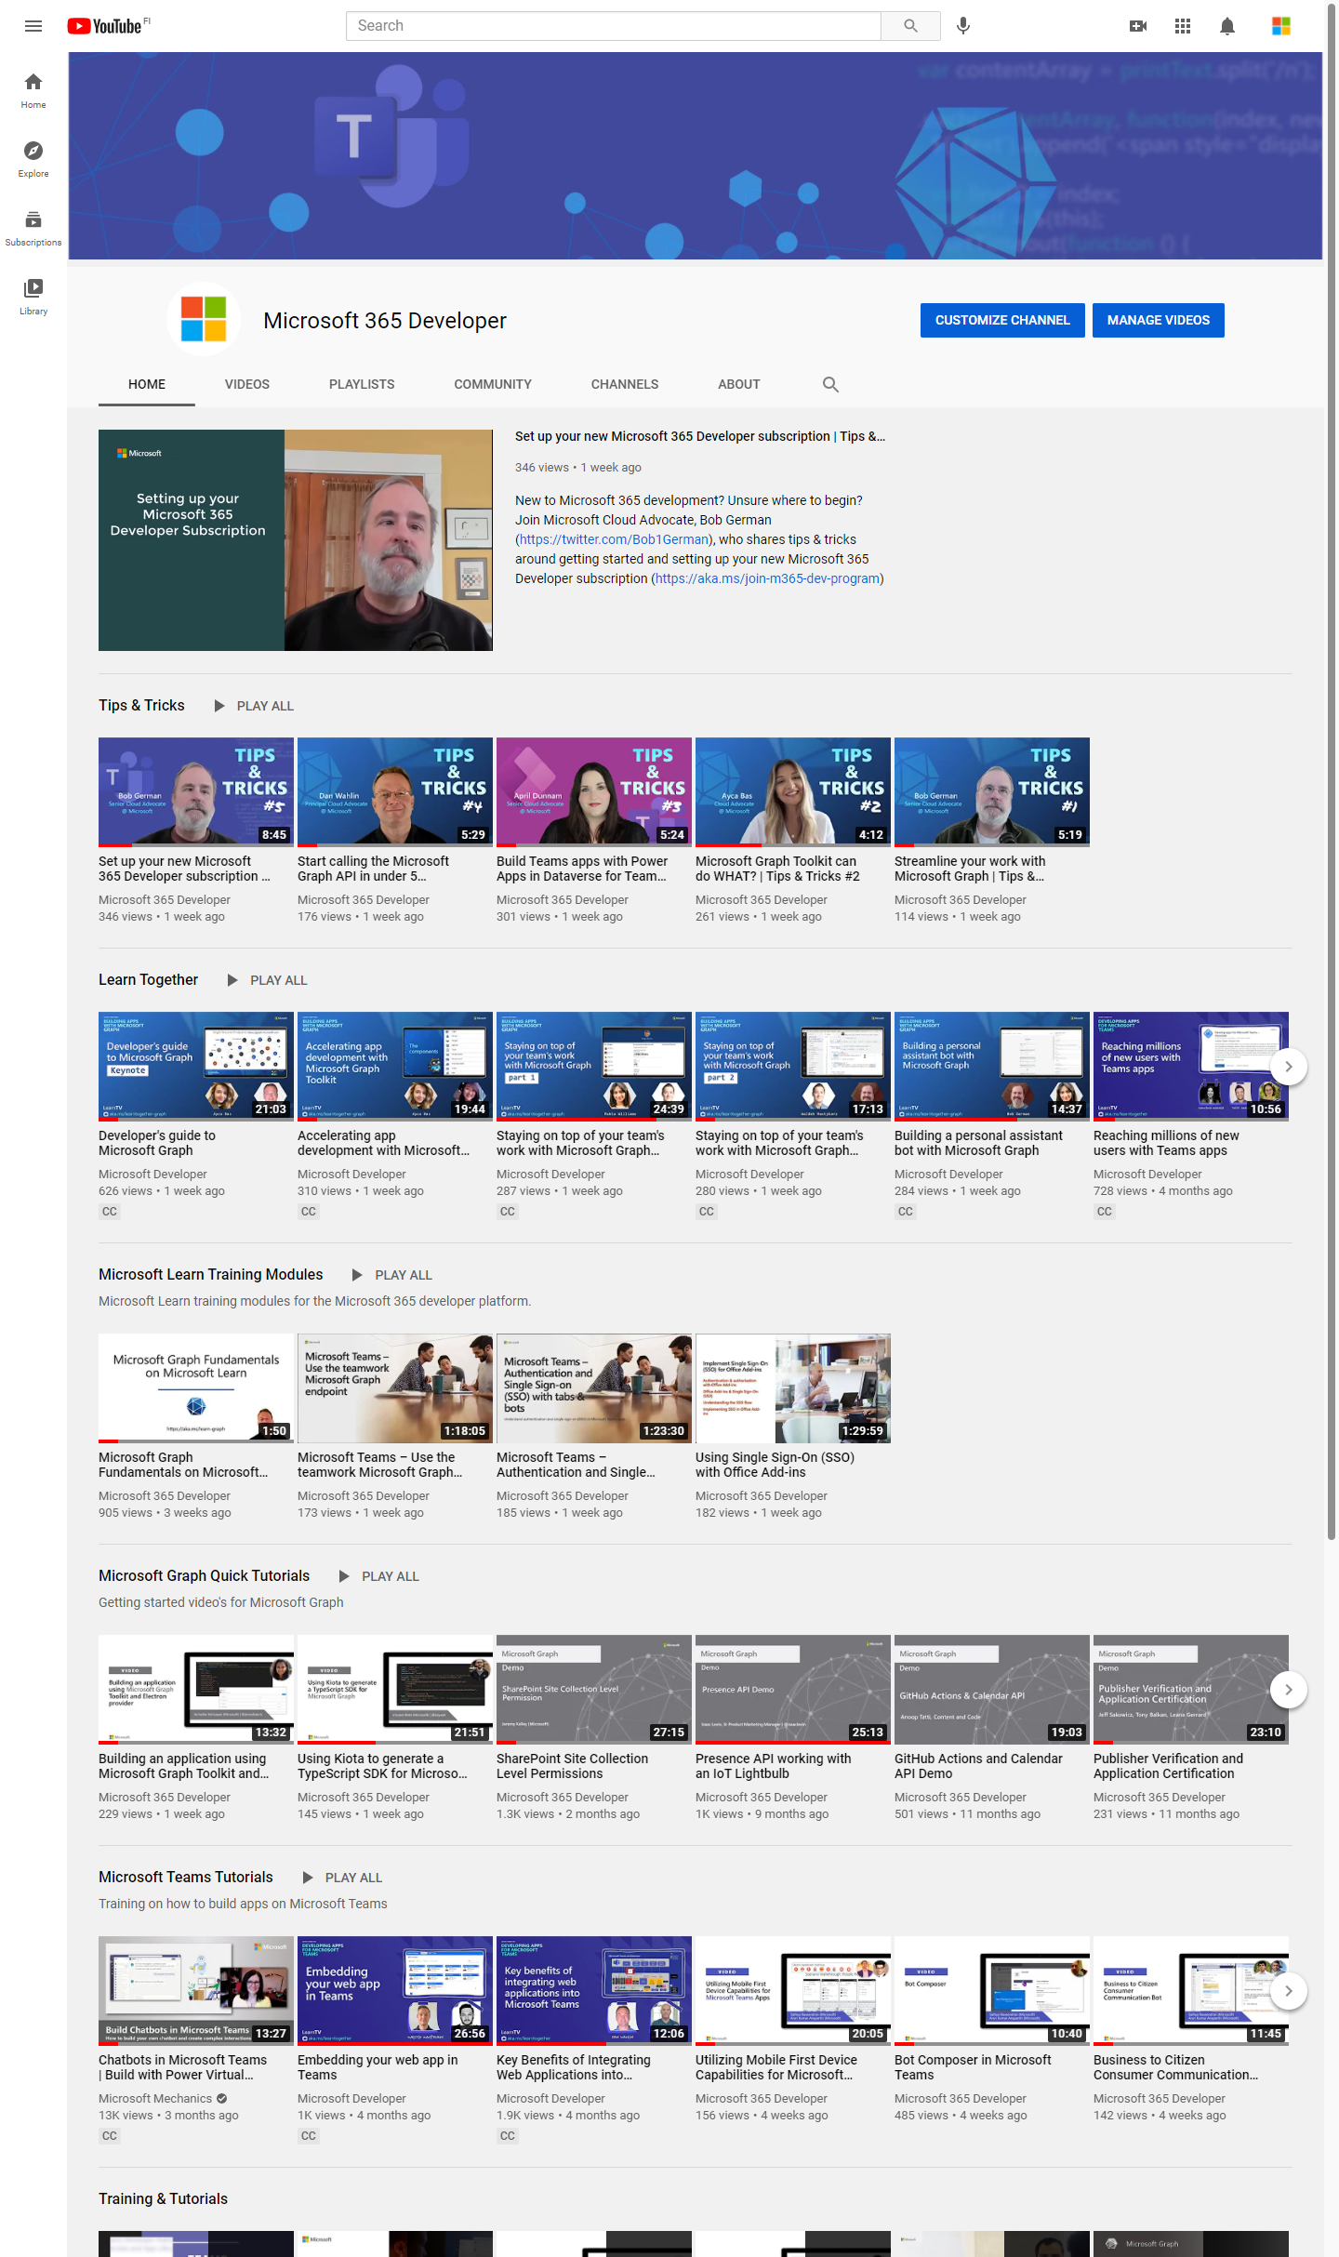
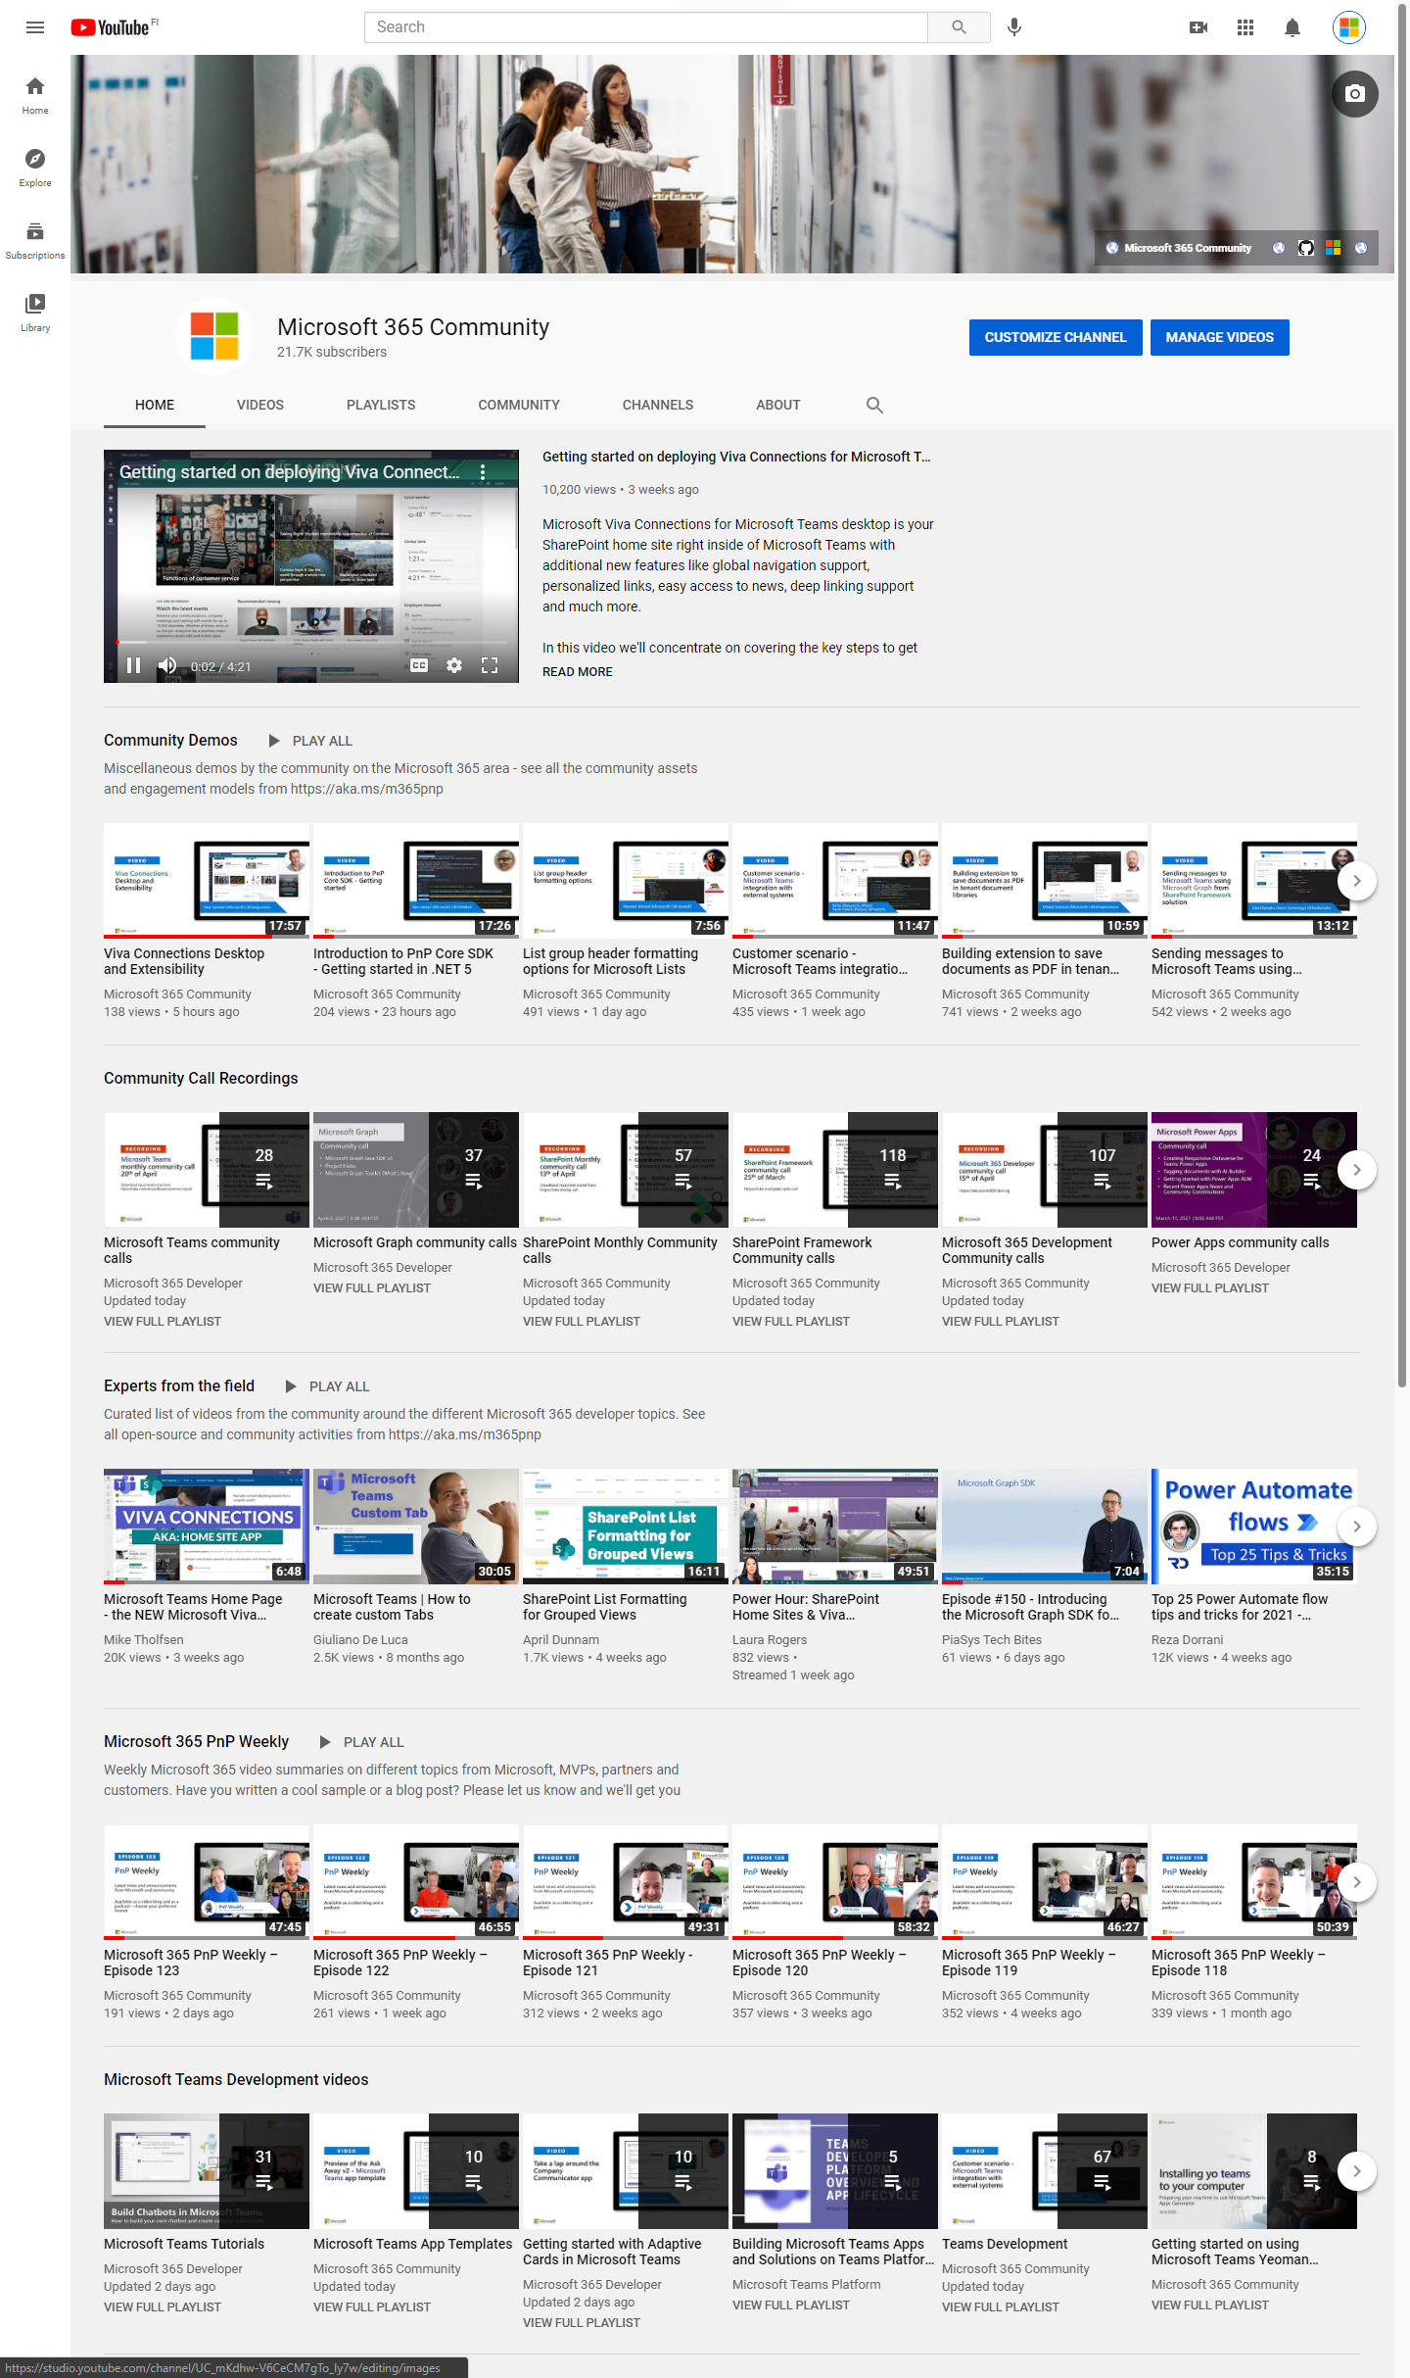
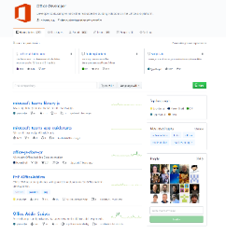
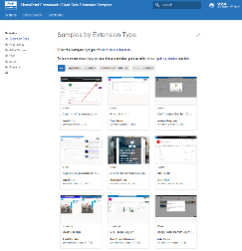
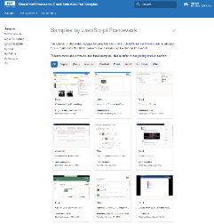
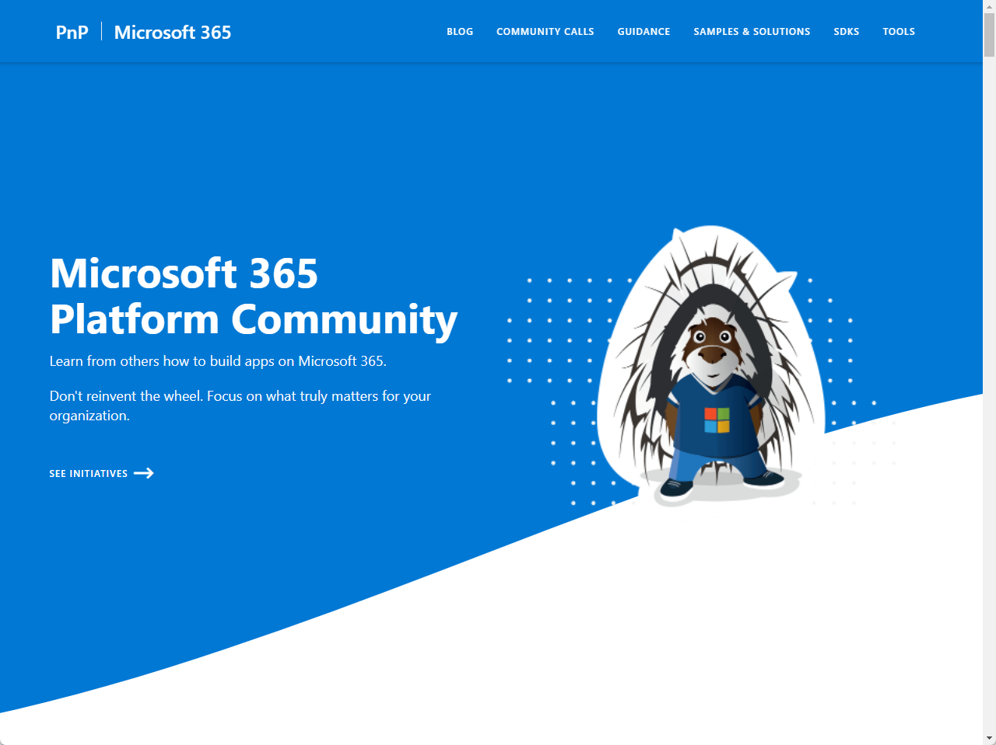
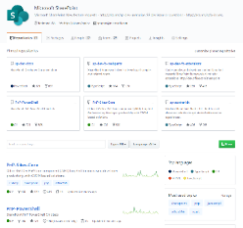
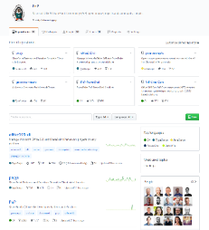
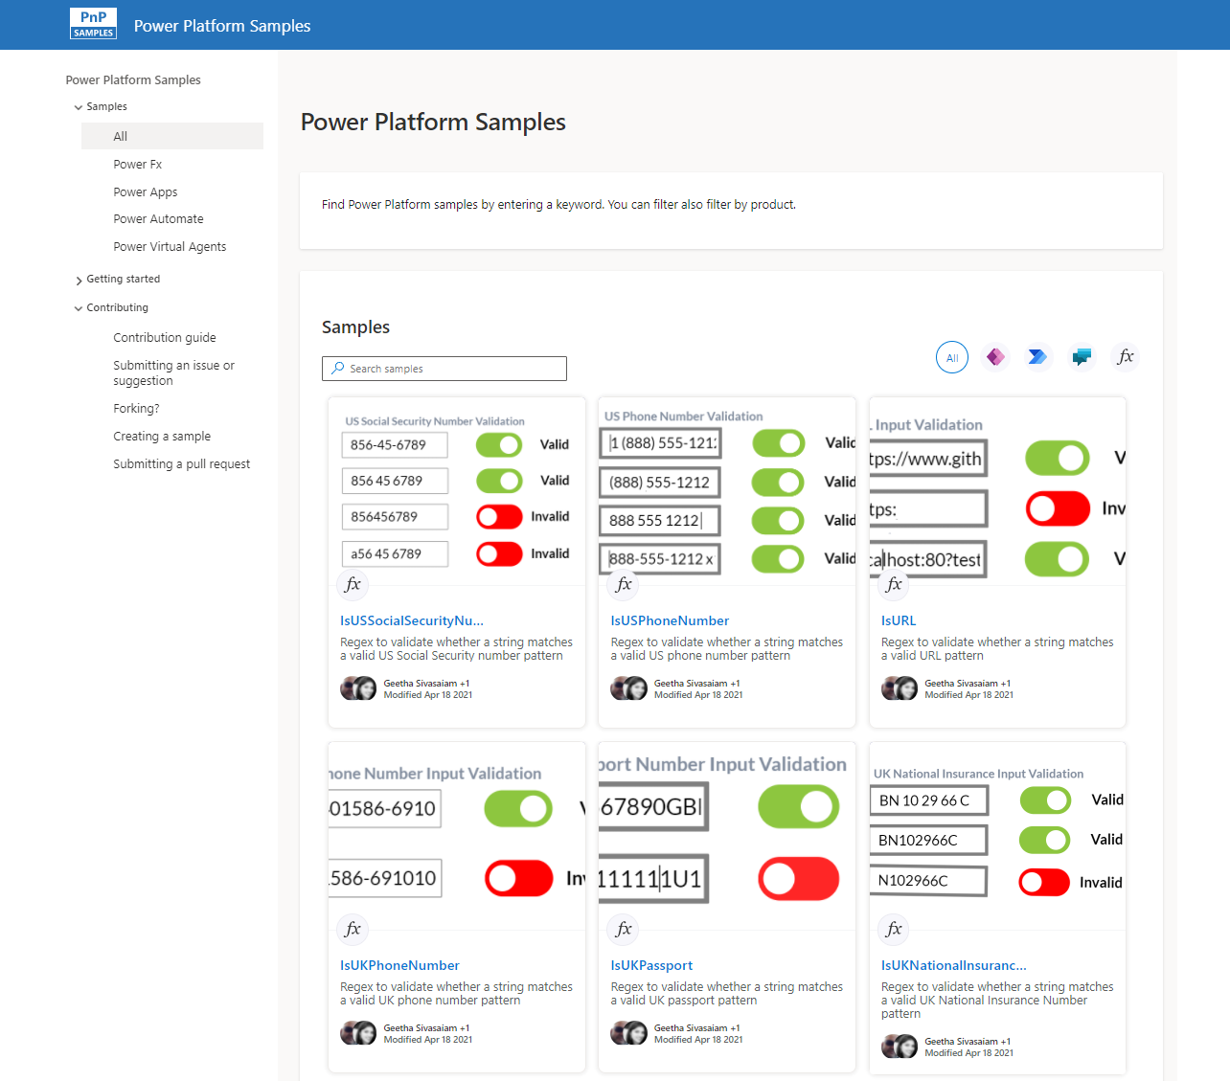
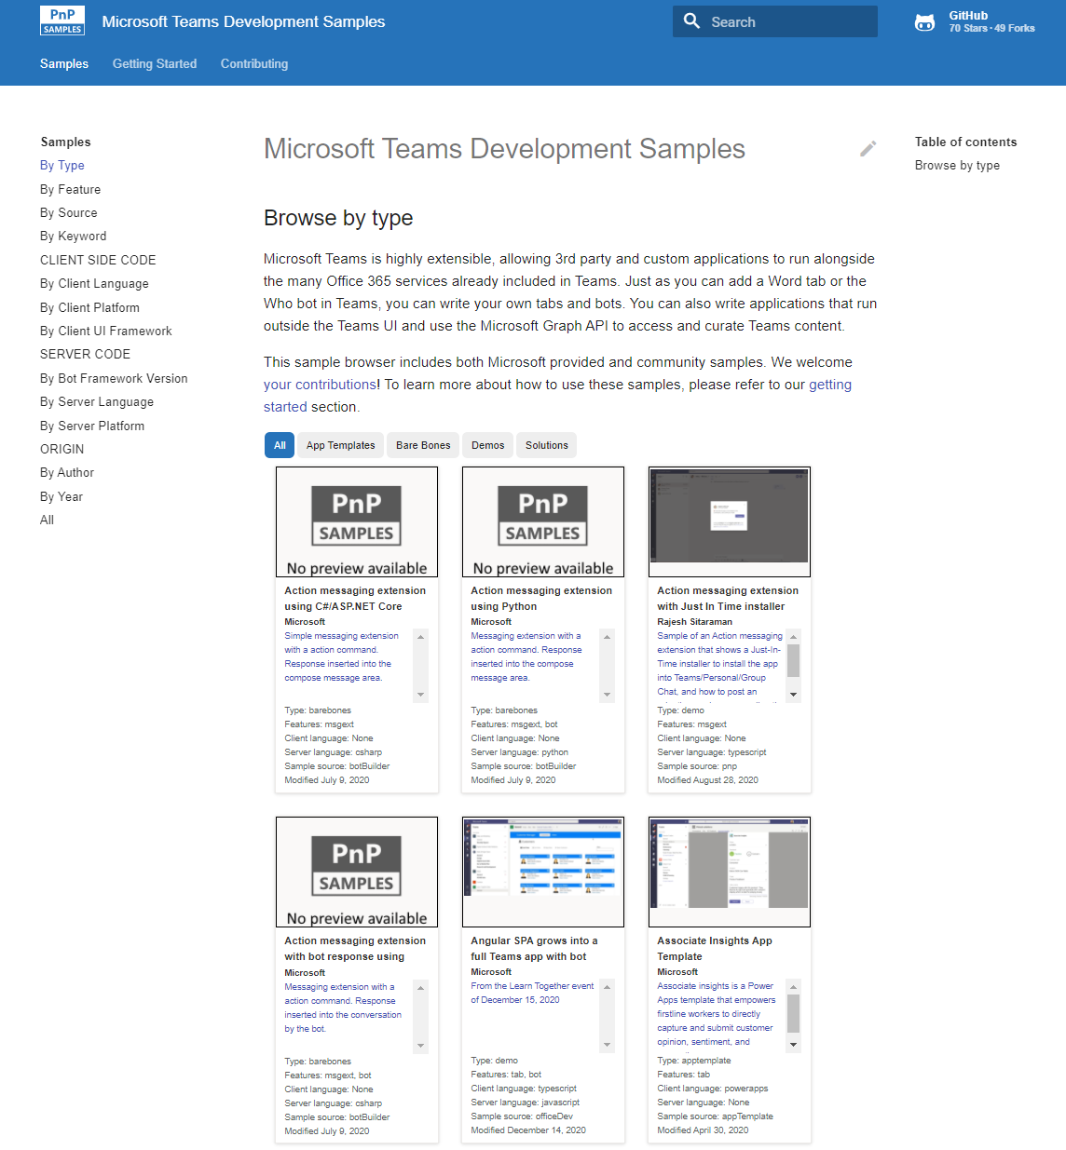
Microsoft 365 developer videos
Microsoft 365 community videos
Open-source
Sample galleries
Open-source initiatives and samples
aka.ms/m365devyoutube
aka.ms/m365/videos
github.com/pnp
github.com/officedev
github.com/sharepoint
github.com/microsoftgraph
aka.ms/m365/samples
aka.ms/teams-samples
aka.ms/spfx-webparts
aka.ms/powerplatform-samples
aka.ms/spfx-extensions
aka.ms/list-formatting
aka.ms/m365/community
@Microsoft365Dev | @m365pnp

Slide 4
Microsoft 365 developer community calls
Microsoft 365 platform (weekly) https://aka.ms/m365-dev-call
(Notice. This call is on a summer break between July 1st and 31st of August 2022)
Adaptive Cards https://aka.ms/adaptivecardscommunitycall
Microsoft identity platform https://aka.ms/IDDevCommunityCalendar
Office Add-ins https://aka.ms/officeaddinscommunitycall
Power Platform https://aka.ms/PowerAppsMonthlyCall
Microsoft 365 and Power Platform community (bi-weekly) https://aka.ms/m365-dev-sig
Viva Connections & SharePoint Framework (bi-weekly) https://aka.ms/spfx-call
Download recurrent invites from
https://aka.ms/m365/calls
Notes:
m365-dev-sig

Slide 5
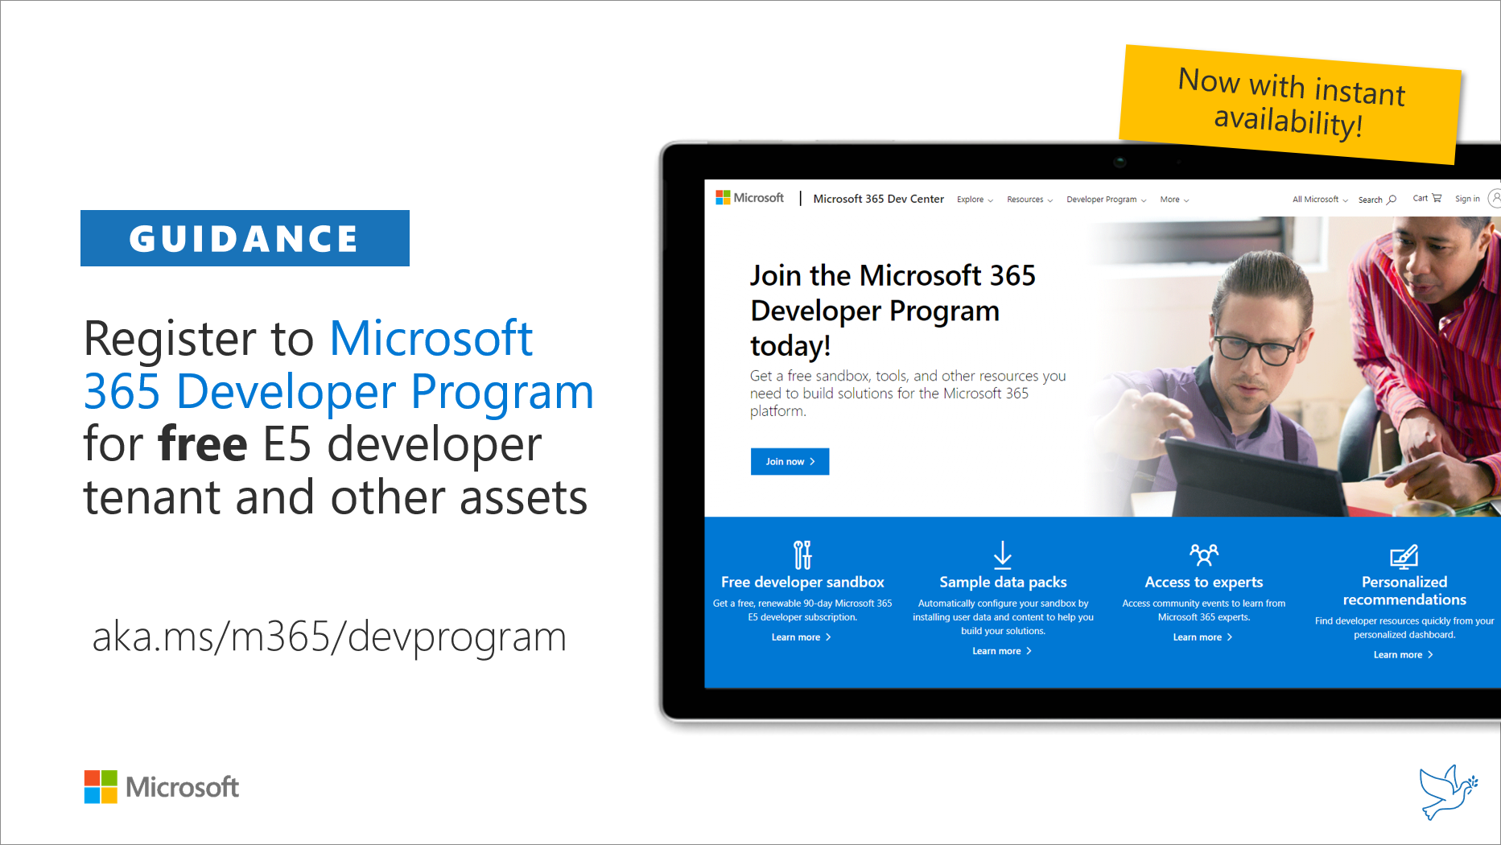
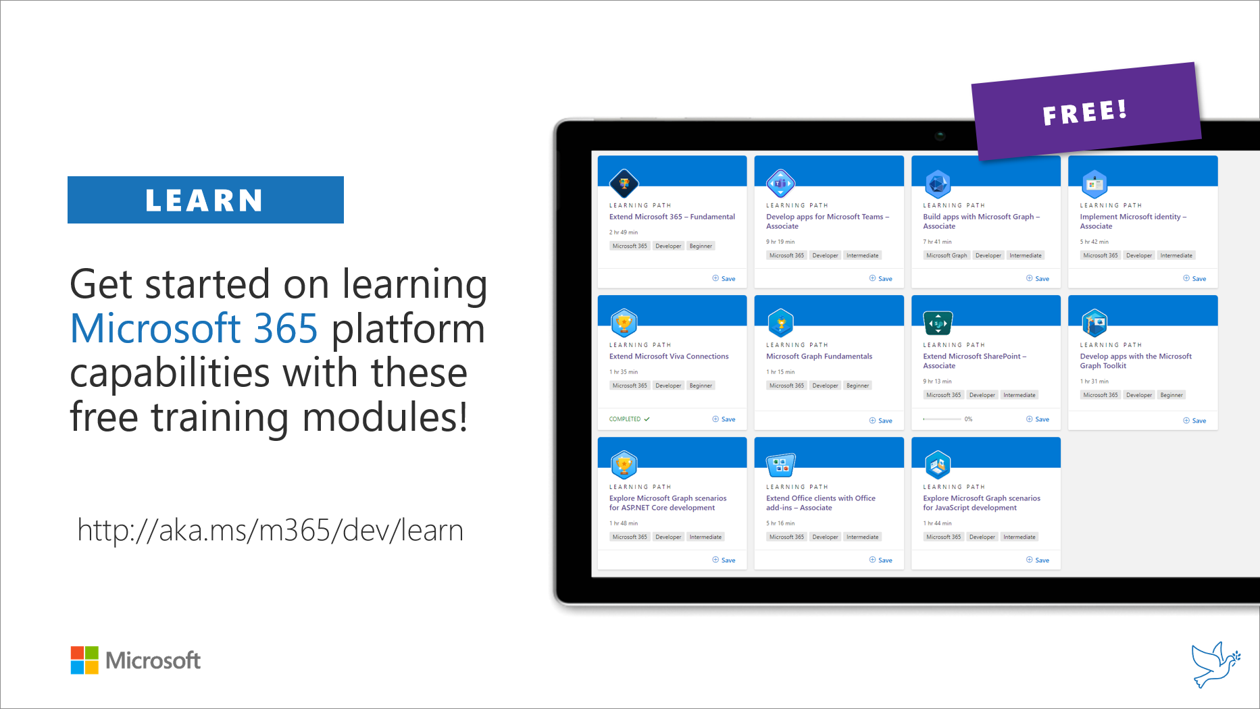
Getting started assets for Microsoft 365 dev
aka.ms/m365/devprogram
aka.ms/m365/dev/learn

Slide 6

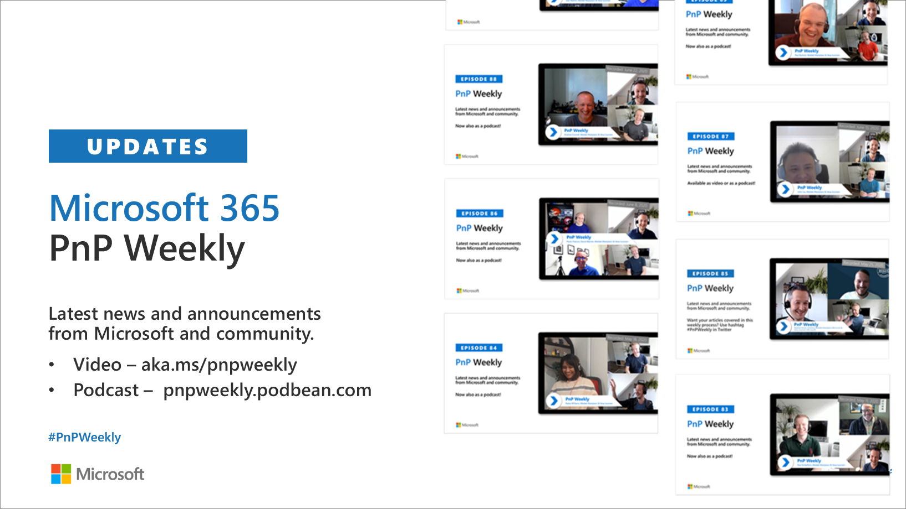
Microsoft 365 Developer podcasts
m365devpodcast.com
Video – aka.ms/pnpweekly
Podcast – pnpweekly.podbean.com

Slide 7
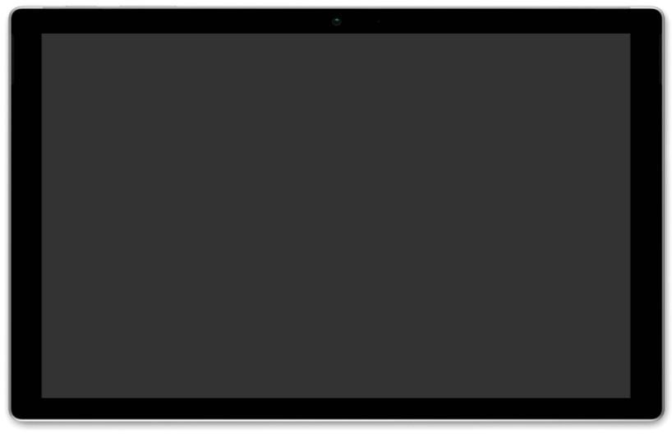
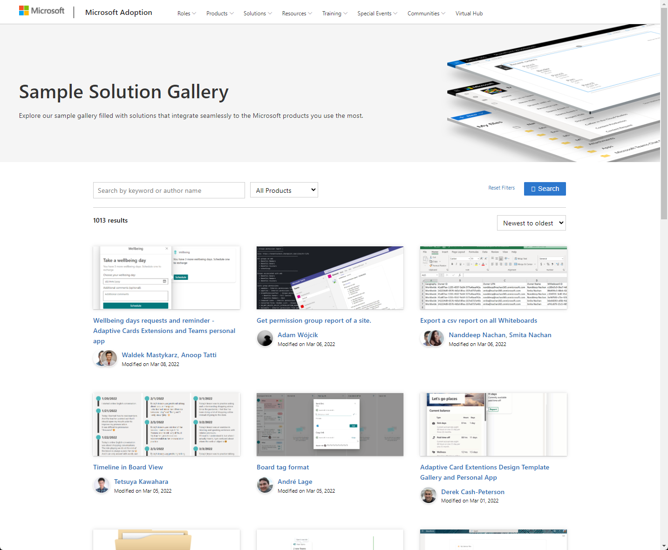
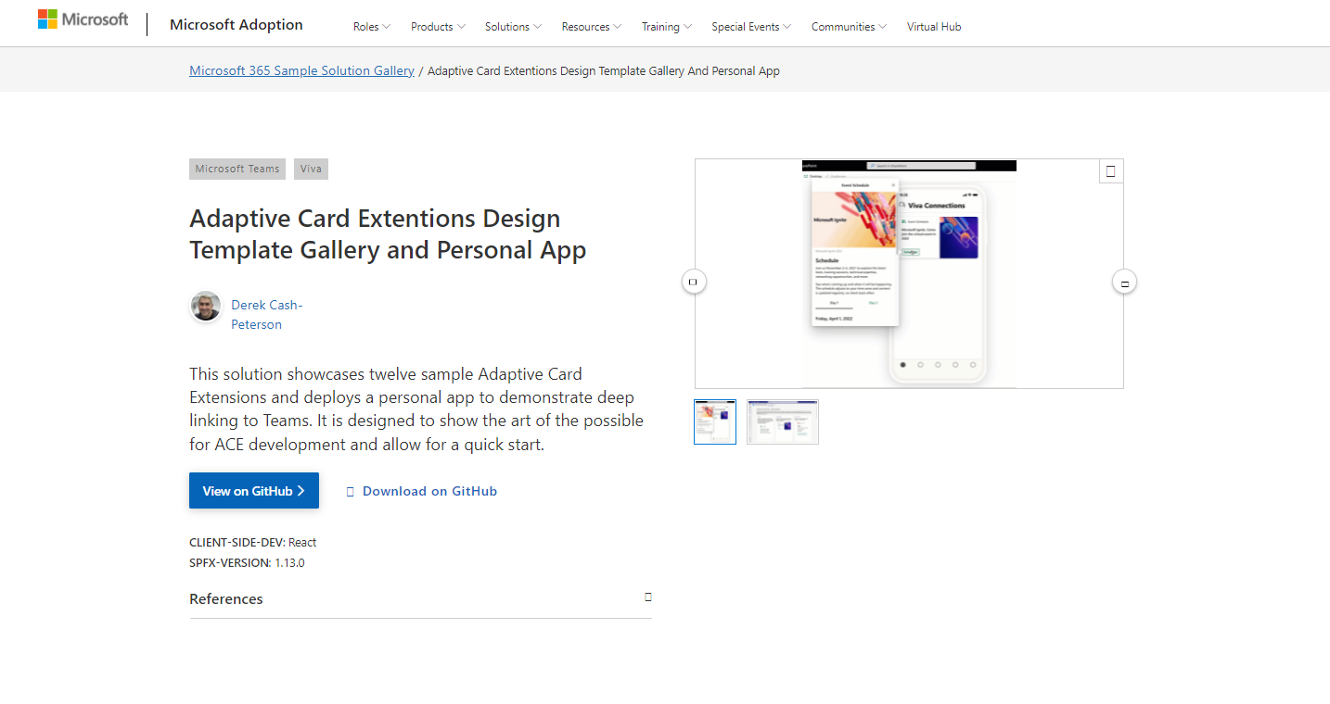
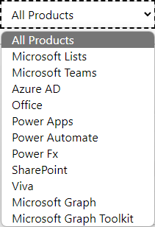
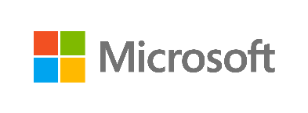
SAMPLES
New Microsoft 365 sample gallery with more than 500 samples from Microsoft and community
1090
aka.ms/m365/samples

Slide 8
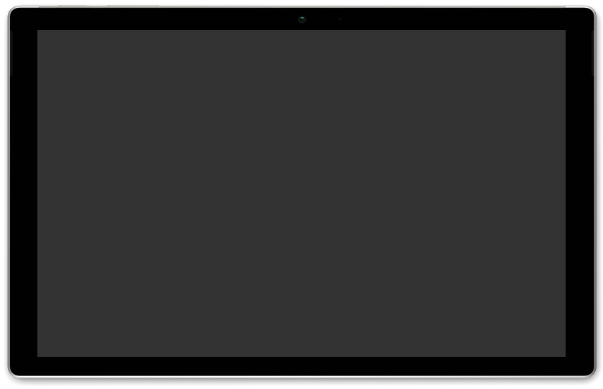
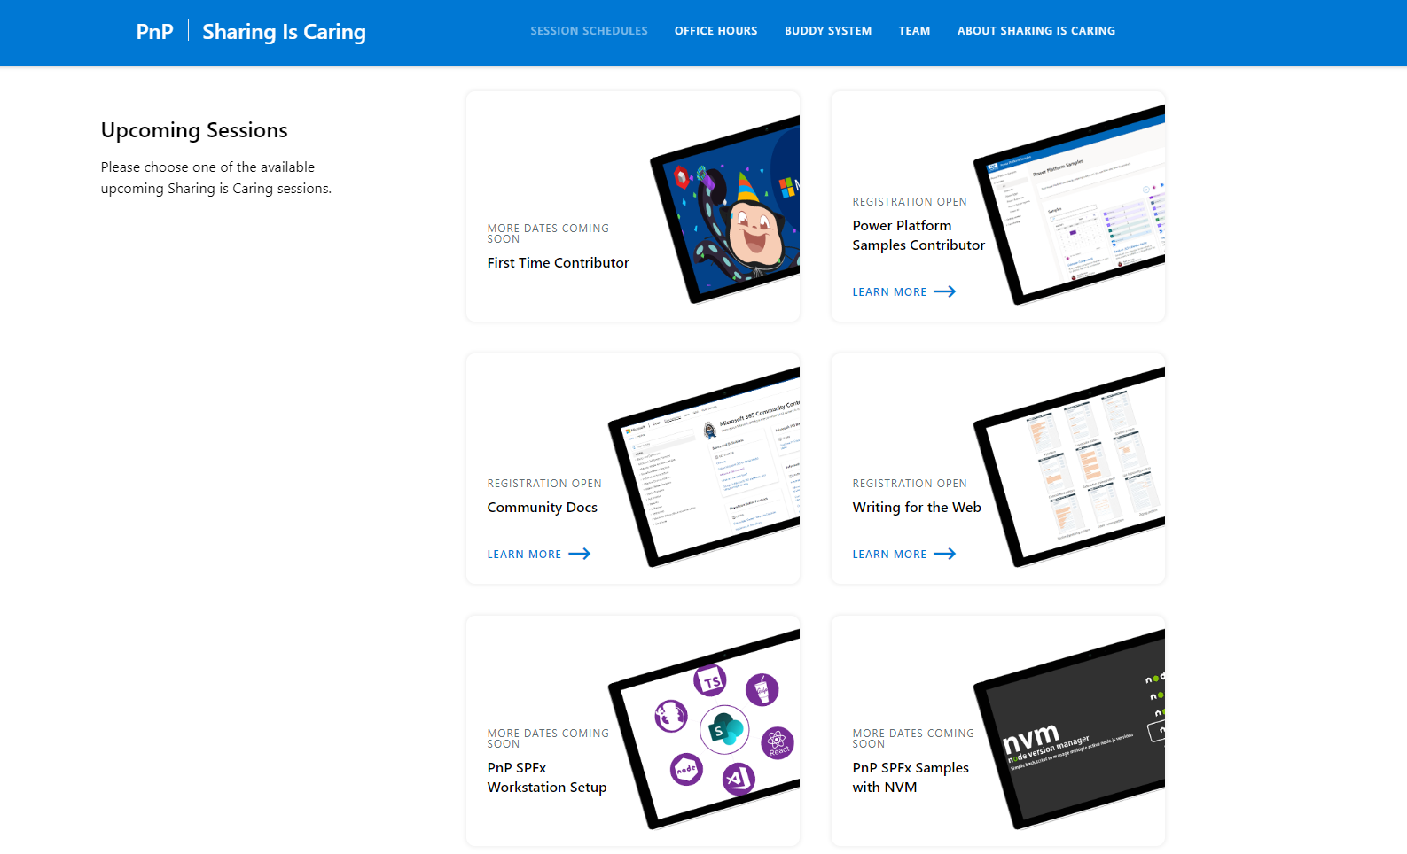
GUIDANCE
Learn how to get started in the open-source PnP community!
Upcoming Sessions:
General First Time Contributor
Power Platform Samples Contributor
Writing for the Web
SPFx Developer Workstation Setup
Using PnP SPFx samples w/ NVM
More than code with VS Code
First-time presenter
M365 Maturity Model Practitioners
Power Platform - Power Pages – Coming Soon!!!
https://aka.ms/sharing-is-caring
Notes:
25 Total attendees, 16 attendees who attended both First-Time Contributors and Community Docs sessions.

Slide 9

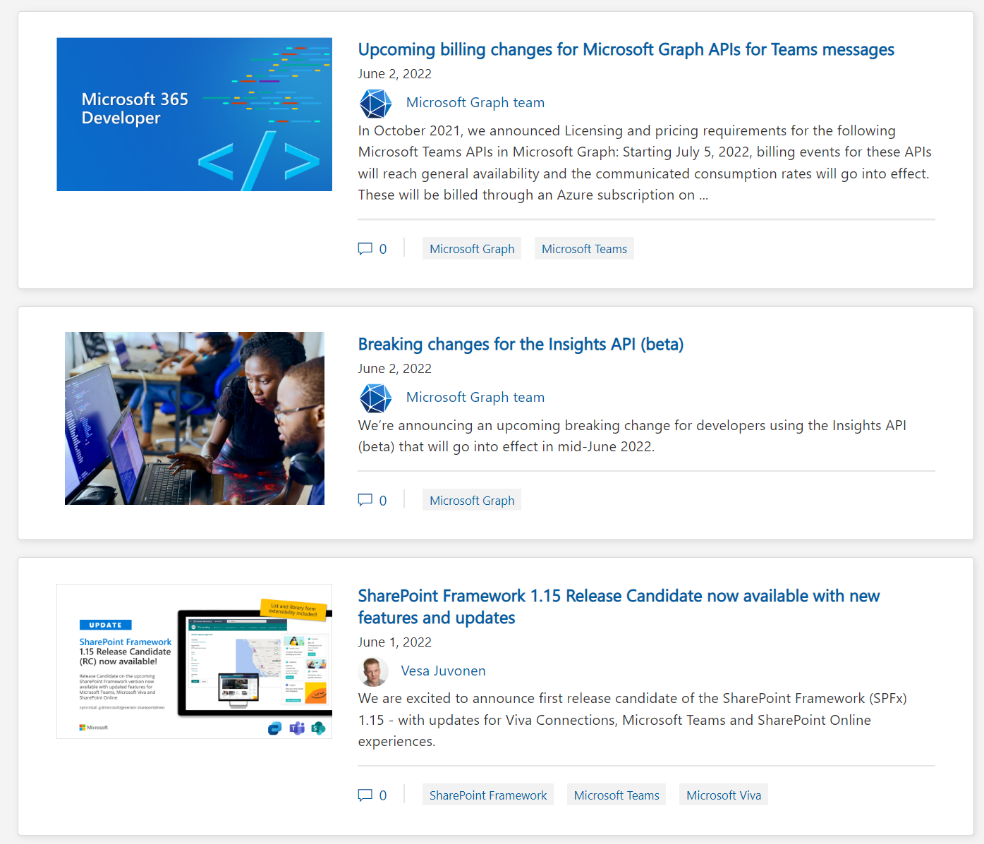
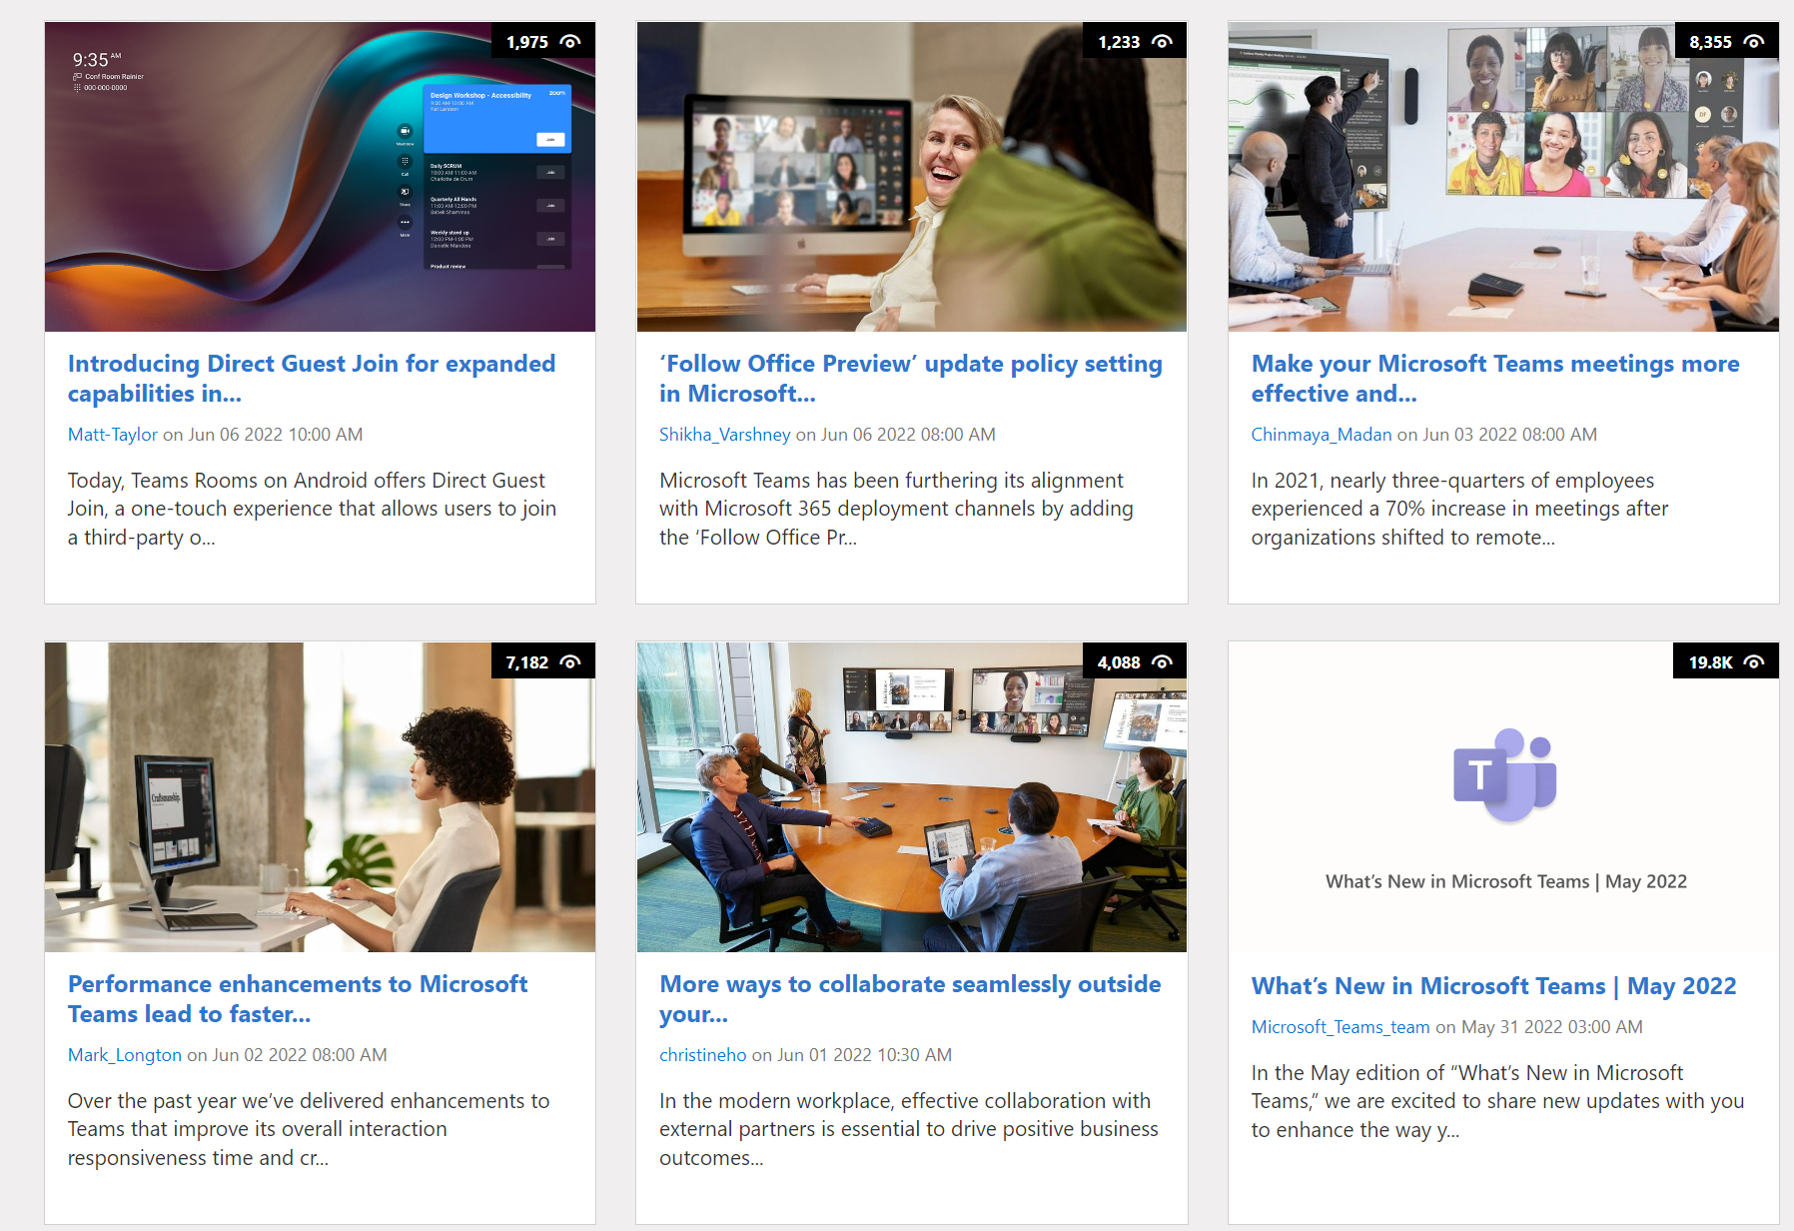
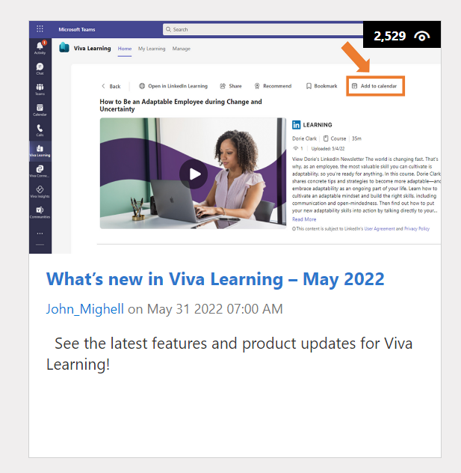
https://aka.ms/m365dev/blog
https://aka.ms/teams/blog
https://aka.ms/microsoftviva/blog

Slide 10
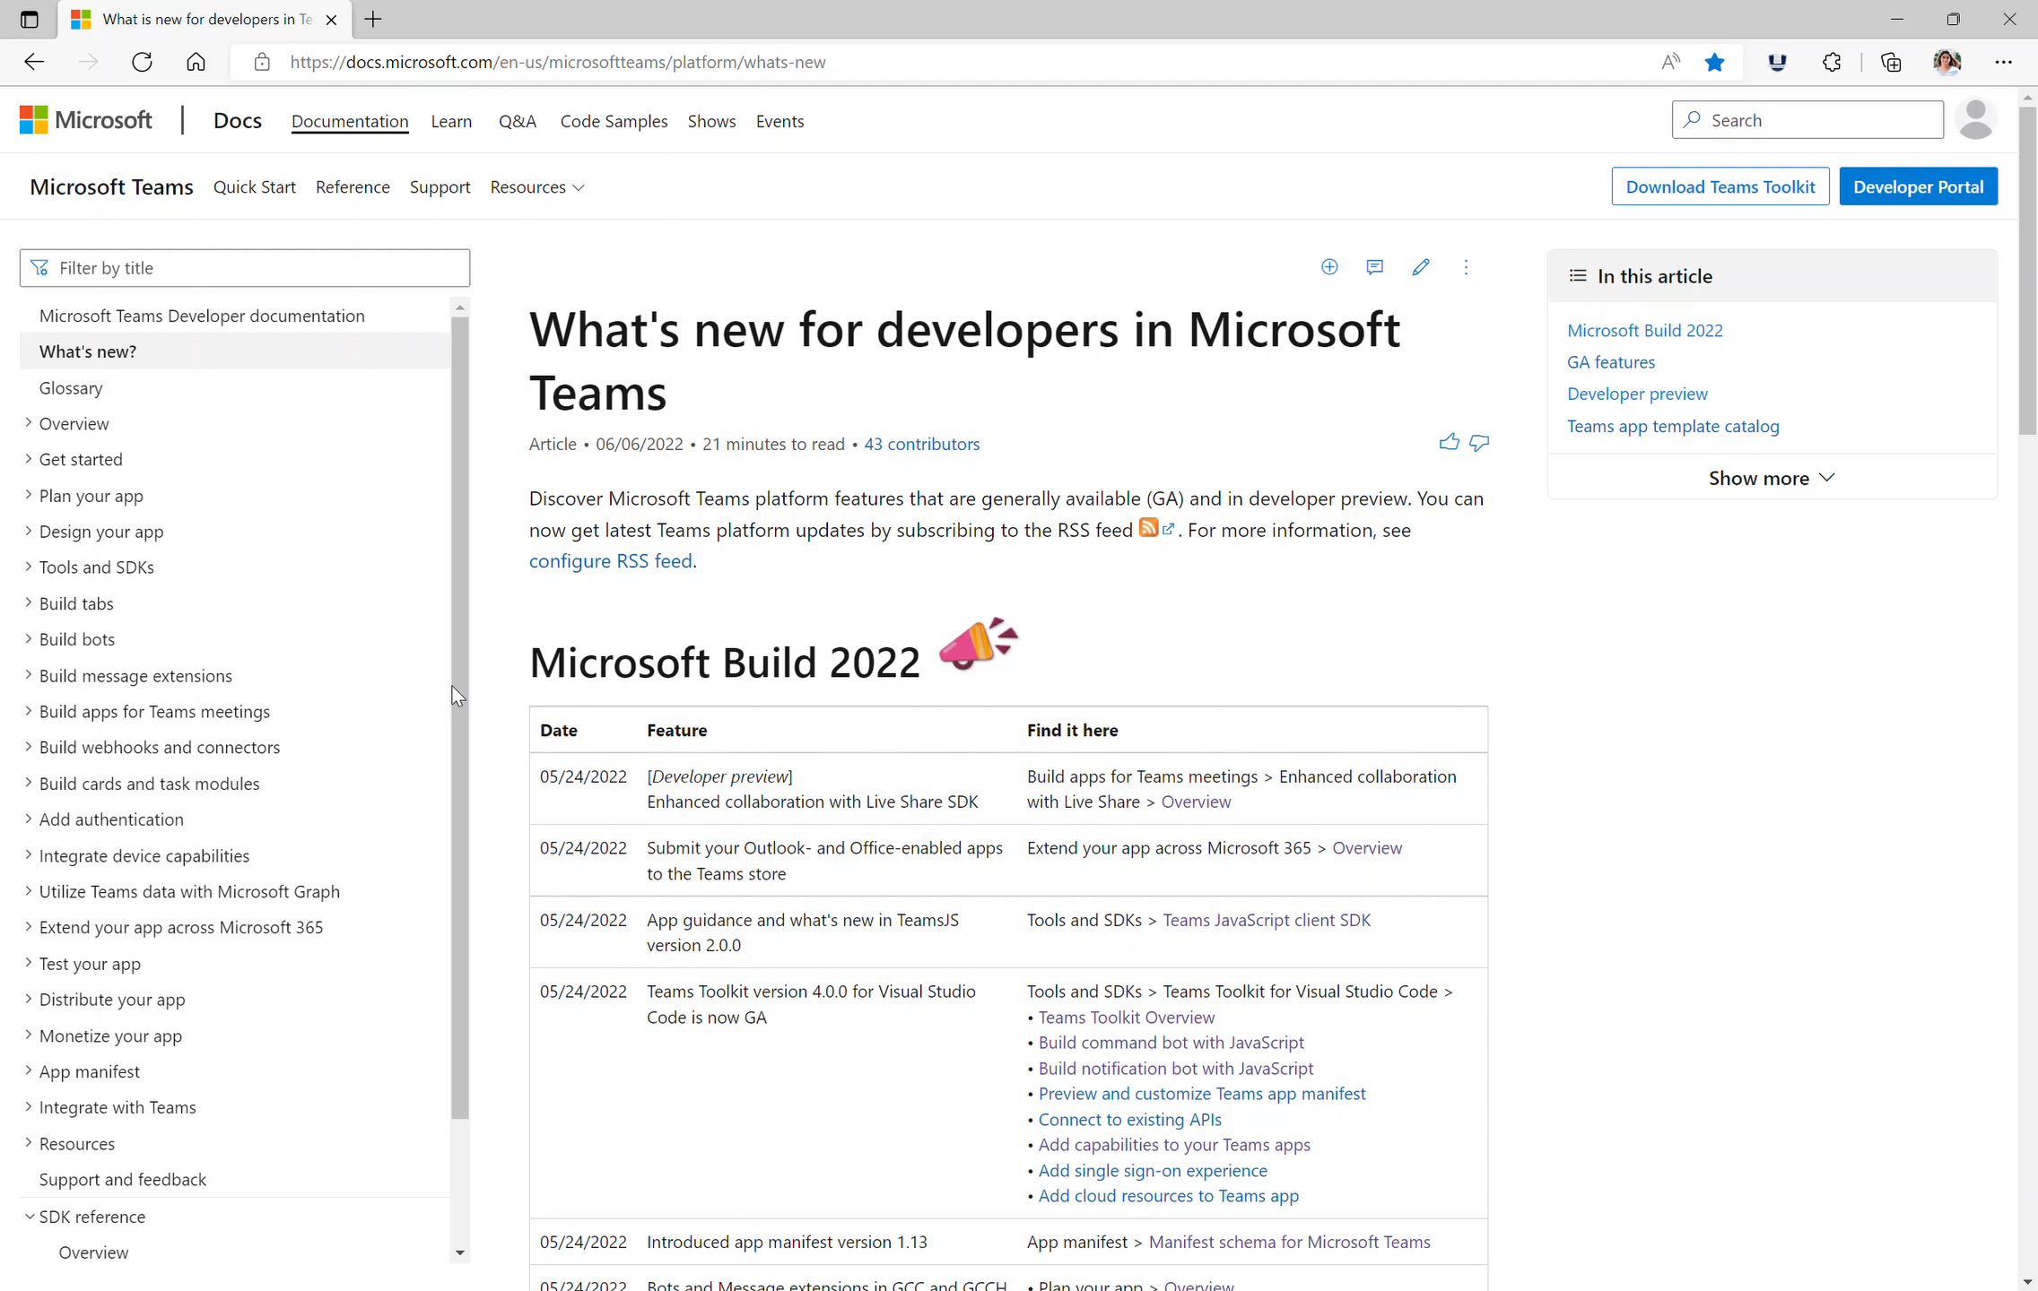
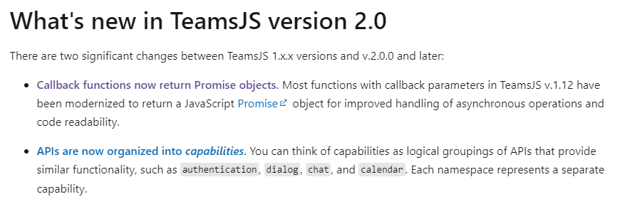






Teams Platform updates Sample code
Doc updates Enable SSO for tab apps
1
SDK V2 updates for Sample code
3
2
ADAL to MSAL updates
Docs: http://aka.ms/TeamsDevDocs >Add authentication > Tabs > Enable SSO for tab apps
Repo: aka.ms/TeamsSamples
@Microsoft365Dev
aka.ms/TeamsPlatformUpdates
aka.ms/TeamsDevDocs
aka.ms/TeamsSamples
aka.ms/TeamsPlatformFeedback
Notes:
Wajeed covering 6/7/2022 Hello everyone. I’d walk you through the platform and documentation updates. Let’s start with the platform update on the left side.
We recently released version 2.0 for Teams client SDK. Starting with this new version the existing Teams client SDK has been refactored to enable Teams apps to run in Outlook and Office. From a functional perspective, the latest version of TeamsJS is backward compatible so that your existing code doesn’t break. We also updated all our samples to use the latest SDK. Please feel free to try this new SDK and share you feedback.
Based on the feedback we received, we also updated our authentication samples to use MSAL 2.0 library. Please feel free to try out the samples, these are located at aka.ms/TeamsSamples and provide feedback if any.
3. Now let’s move to the doc updates on the right:
We got lot of feedback on Teams authentication module so we are revamping the Authentication documentation. This activity is being performed in phases. As part of phase one, we’ve revamped the enable SSO for tabs app section. We’ve got:
- Clarity of steps and procedures for authentication
- Understanding of difference between SSO and non-SSO authentication methods
- Requirements and correct technical process for basic implementation of SSO authentication in a tab app
- Improving discoverability of content by correcting ToC structure and page names.
- The module must have sections such as Final output or behavior, help for the users to choose between options, and Troubleshooting guide
As next steps, we’d be working on Bots and ME authentication followed by Third party IdPs.
Enabling SSO for Teams bot apps
Enabling SSO for message extension apps
Revamping third party OAuth IdPs authentication methods for tabs, bots, and message extension
Enhancing flow for entire Add Authentication module
Plan authentication for your app module
So, these were the platform updates, if you have any feedback or suggestion, please post on aka.ms/TeamsPlatformFeedback- the link is available in the footer. You could also follow us on twitter and configure to the RSS feeds to get regular platform updates.

Slide 11



Optional picture time!
Video on and we’ll grab a Together Mode pic with those who are willing to do this.
We are together on this as a community!
Let’s all be like Seb
By enabling your camera for the picture, you grant us permission to share your picture in social media.

Slide 12

DEMO
Migrate your SharePoint workflows to Power Automate with migration tooling (preview) – Zac Sun
Send a SMS message with Azure Communication Services – Dan Wahlin
TeamsJS SDK V2 to extend your Microsoft Teams solutions to Outlook and Office – Bob German

Slide 13
Thank you
Recording will be available in 24 hours on
Microsoft 365 Community (PnP) YouTube channel
https://aka.ms/M365PnP/videos
(subscribe today)
Follow us on Twitter
@Microsoft365Dev | @M365PnP
Next Microsoft 365 Platform call: June 14th at 08:00 am PT
All available community calls from https://aka.ms/m365/calls

Slide 14
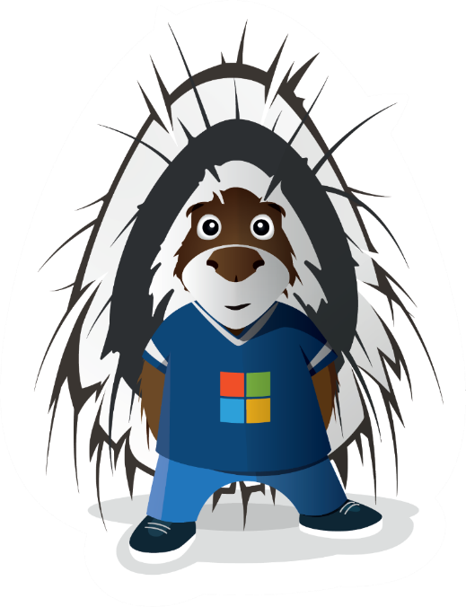


aka.ms/m365pnp

